Slide 1
Speaking of Social Dissidents and Iconoclasts…
Now Presenting-
American Philosophers, Romantics, Gothics, and Transcendentalists
Asking the question:

Slide 2
Are humans inherently good or evil?
Answer and provide examples.

Slide 3
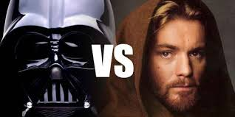
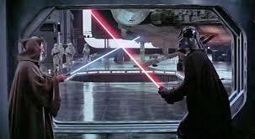
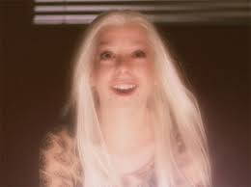
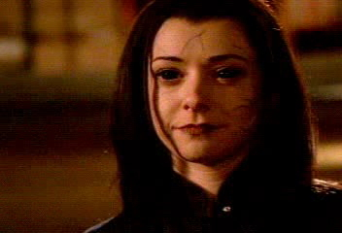
The Light Side or Dark Side
Good Witch or a Bad Witch?

Slide 4
Moral Dilemmas
You work at a bank. Another employee, who you consider incompetent, is blamed for your error involving thousands of dollars. The error cannot be traced. Do you own up to it?
Your cat has been lost for three months. You discover that strangers found your beloved pet injured in a ditch, paid $300 for veterinary care, and adopted it. Do you let them keep it?
You have to choose a group for a class project. A friend, who does not do well in the course, wants to be in your group. Another student, who you are not very fond of but has an A in the class, also wants to work with you. Do you choose your friend?

Slide 5
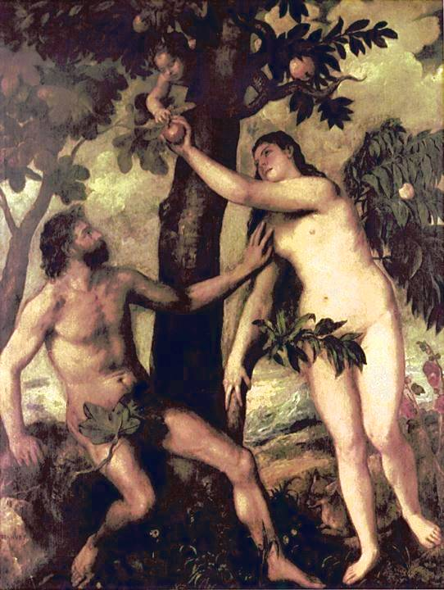
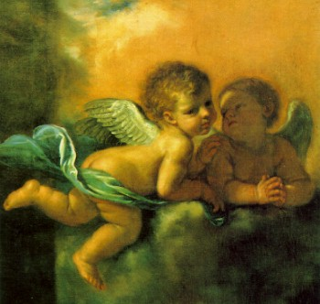

Born Bad or Good?
Puritans
Sinful
Enlightenment
Blank Slate
Transcendentalists
Good

Slide 6
Transcendental Philosophies
An ideal spiritual state exists that transcends (exists beyond) our physical state
  This is a personal experience, discovered through intuition – not studying religion

Slide 7
Transcendental Philosophies
Belief in the “Oversoul”
  Not quite God, not just nature – divine entity that overlooks all things
  This entity is present in all things and all people

Slide 8
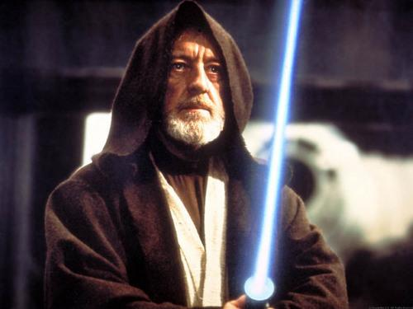
Oversoul

Slide 9
Transcendental Philosophies
Interconnectedness of all things
  Nature serves as a mirror to our own lives (or, we can see an example of every facet of human nature in some aspect of physical nature. For example, the veins in a leaf mirror the veins in our bodies).

Slide 10
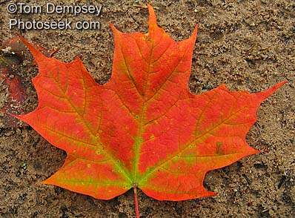
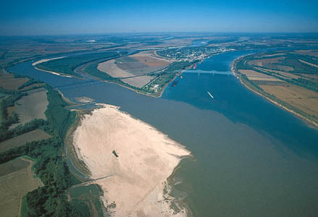
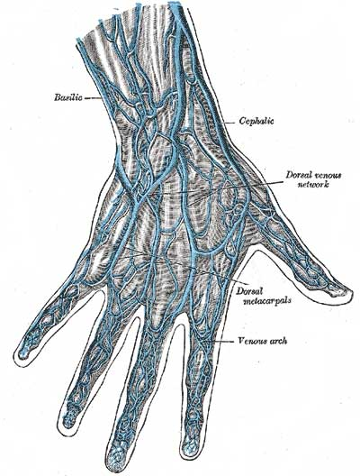

Nature presents reflections of itself

Slide 11
Transcendental Philosophies
Concern for this life is more important than concern for the afterlife
  At death, the soul returns to the Oversoul
  Emphasis on human thought

Slide 12
Transcendental motif
As with all literature, there are multiple motifs present in Transcendental works. However, we will be tracking three:
  The inherent goodness of man
  The interconnectedness of the world
  The beauty and peace of nature

Slide 13
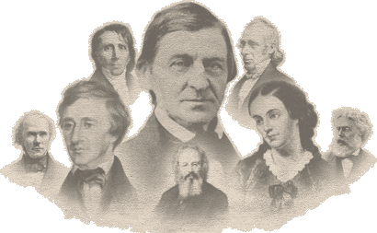
Transcendentalist Authors

Slide 14
Famous Transcendentalists
Ralph Waldo Emerson
Henry David Thoreau
William Ellery Channing
Theodore Parker
Margaret Fuller
Amos Bronson Alcott
Elizabeth Palmer Peabody

Slide 15
Margaret Fuller (1810 - 1850)
American writer, journalist, and philosopher, was part of the Transcendentalist circle.
Margaret Fuller's "conversations" encouraged the women of Boston to develop their intellectual capacities.
In 1845 Margaret Fuller published Woman in the Nineteenth Century, now considered an early feminist classic.

Slide 16
Margaret Fuller
“What woman needs is not as a woman to act or rule, but as a nature to grow, as an intellect to discern, as a soul to live freely, and unimpeded to unfold such powers as were given her when we left our common home.”
“In order that she may be able to give her hand with dignity, she must be able to stand alone.”
“I now know all the people worth knowing in America, and I find no intellect comparable to my own.”

Slide 17
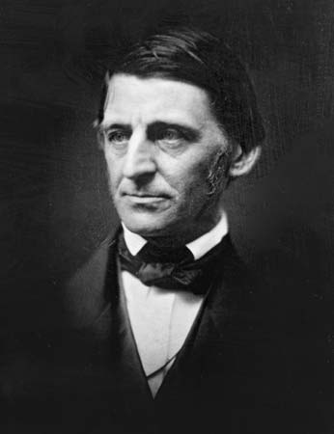
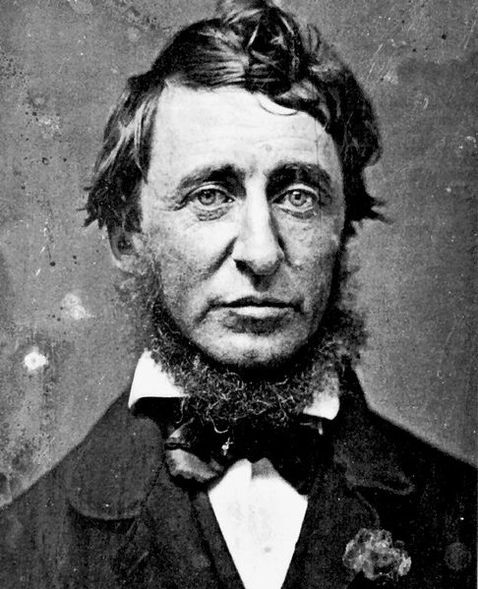
Ralph Waldo Emerson
Henry David Thoreau

Slide 18
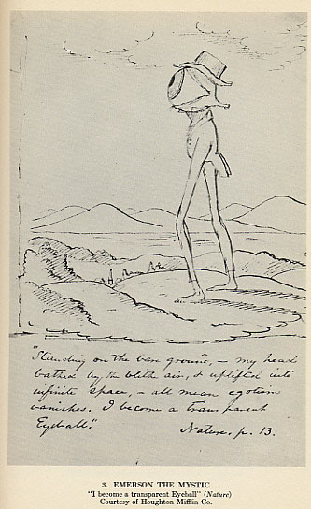

Slide 20

Ralph Waldo Emerson (1803-1882)
Often thought of as the “father” of American literature
First to express the idea of Transcendentalism
  His work Nature is thought to be the catalyst for the Transcendental movement

Slide 21
Emerson
Harvard educated and ordained as a Unitarian minister at the Harvard Divinity School
  Found much of what he was taught unsatisfying and resigned in 1832
Known as a great orator during his lifetime
Sought a breakdown of previously accepted conventions
  Scholar and worker
  Thinking and acting
  Practical and fantasy

Slide 22
“Self-Reliance” - Emerson
“There is a time in every man’s education when he arrives at the conviction that envy is ignorance; that imitation is suicide…”
“Trust thyself…”

Slide 23
“Self-Reliance” - Emerson
“Whoso would be a man, must be a nonconformist.”
“Nothing is at last sacred but the integrity of your own mind.”

Slide 24
“No law can be sacred to me but that of my own nature. Good and bad are but names very readily transferable to that or this; the only right is what is after my constitution; the only wrong what is against it…”

Slide 25
“Speak what you think now in hard words and tomorrow speak what tomorrow thinks in hard words again, though it contradict every thing you said today. – ‘Ah, so you shall be sure to be misunderstood.” – Is it so bad then to be misunderstood? Pythagoras was misunderstood, and Socrates, and Jesus, and Luther, and Copernicus, and Galileo, and Newton, and every pure and wise spirit that ever took flesh. To be great is to be misunderstood.”

Slide 26
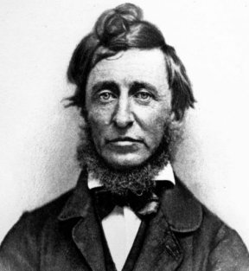
Walden, or
Life in the Woods
Henry David Thoreau

Slide 27
Thoreau criticized the direction in which civilization was going, particularly commercialization:
"To have done anything just for money is to have been truly idle.“
"Most of the luxuries and many of the so-called comforts of life are not only not indispensable, but positive hindrances to the elevation of mankind. " - Walden
"Rather than love, than money, than fame, give me truth." - Walden

Slide 28
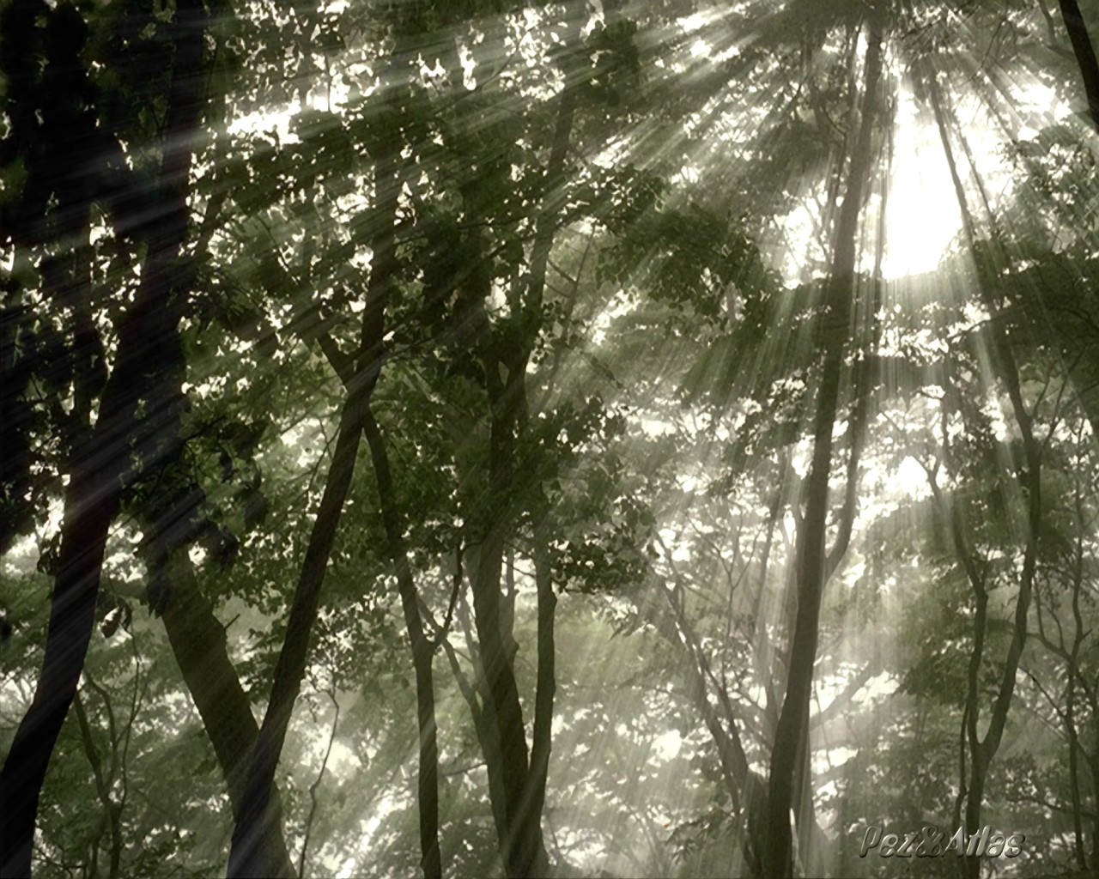
“I went to the woods because I wished to live deliberately, to front only the essential facts of life, and see if I could not learn what it had to teach, and not, when I came to die, discover that I had not lived.”

Slide 29
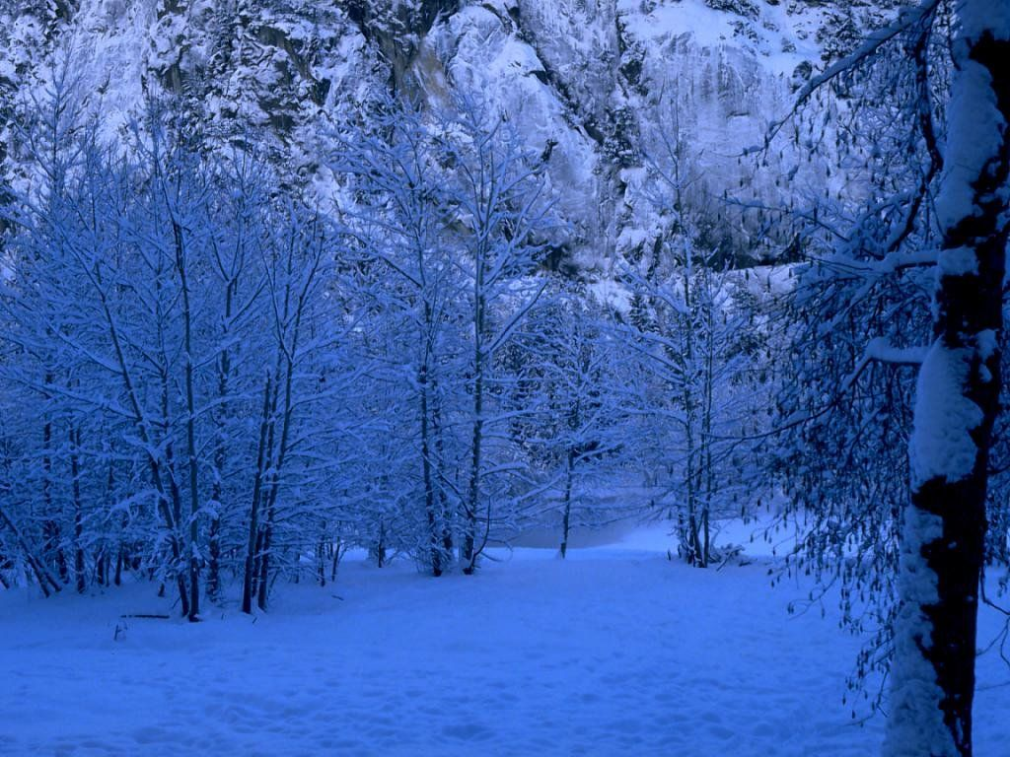
“Heaven is under our feet as well as over our heads.”

Slide 30
“Civil Disobedience”
Thoreau’s essay urging passive, nonviolent resistance to governmental policies to which an individual is morally opposed

Slide 31

Civil Disobedience
Written after Thoreau spent a night in jail after refusing to pay a poll tax.
Thoreau refused to pay the $1.50 tax because the revenues went to the government which was allowing slavery to continue and which was waging an unjust war against Mexico.

Slide 32
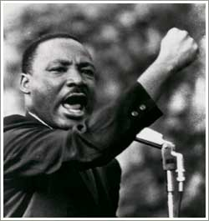
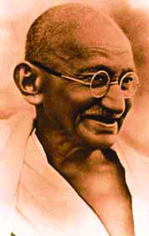
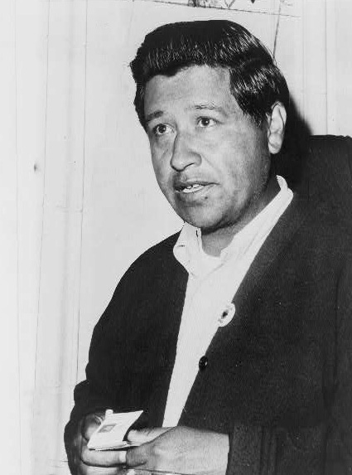
“Civil Disobedience”
Influenced individuals such as Ghandi, Dr. Martin Luther King Jr. & Cesar Chavez
Click on photo for info about each person

Slide 33
“Civil Disobedience”
“That government is best which governs least…That government is best which governs not at all.”
“I ask for, not at once no government, but at once a better government.”
“I cannot for an instant recognize that political organization as my government which is the slave’s government also.”

Slide 34

“If the injustice is part of the necessary friction of the machine of government let it go…but if it is of such a nature that it requires you to be the agent of injustice to another, then, I say, break the law. Let your life be a counter friction to stop the machine.”
Click on the photo for more information.

Slide 35
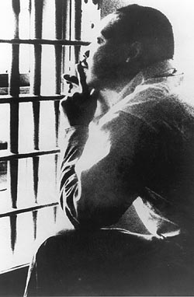
“Under a government which imprisons any unjustly, the true place for a just man is also a prison…It is there that the fugitive slave, and the Mexican prisoner on parole, and the Indian come to plead the wrongs of the race should find them..”

Slide 36
“If a thousand men were not to pay their tax-bills this year, that would not be a violent and bloody measure, as it would be to pay them, and enable the State to commit violence and shed innocent blood. This is, in fact, the definition of a peaceable revolution…”

Slide 37
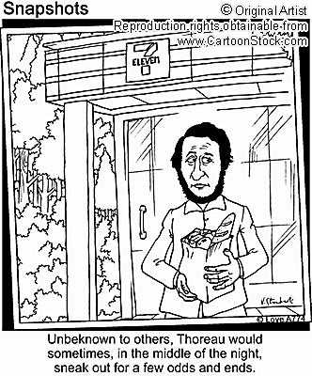

Slide 38
Romanticism
“romanticism” refers to a set of loosely connected attitudes toward nature and humankind, and NOT to romantic love.
The movement known as romanticism sprang up in both Europe and America as a reaction to everything that had come before it:
  The rationalism of 18th-century Age of Reason
  The strict doctrines of Puritanism

Slide 39
American Romanticism
During the late 1700s and early 1800s, romanticism was the dominant literary mode in Europe.
In reaction to the Enlightenment and its emphasis on reason, romanticism stressed emotion, the imagination, and subjectivity of approach.

Slide 40
American Romanticism
Romantic artists, philosophers, and writers saw the limitations of reason and celebrated instead the glories of the individual spirit, the emotions, and the imagination as basic elements of human nature.

Slide 41
Classicism & Romanticism
Classicism
(The Age of Reason)
Reason dominates nature & human nature
Objectivity
Scientific in nature; governed by fixed, unchanging laws
Reason over imagination
Common over individual
Upholds tradition; resists change
Rational thought & logic:
  “I think; therefore, I am.”
Romanticism
Greater personal freedom for the individual
Emphasis on emotions
Subjectivity
Intuition (inner perception of truth)
Imagination
Social progress & spiritual growth
Humanitarian reform (abolitionists, feminism)
Change, growth, development
democracy

Slide 42
Historical Context
19th Century America
Unrestrained growth in U.S.
  1803-1853: area of U.S. increases from 846,000 to 2,181,000.
  1800-1850: population of U.S. increases from 5 million to over 23 million
Westward expansion
Technological advancements (i.e. steel plow, telegraph, cotton gin)
Transportation Improvements (canals, railroads)

Slide 43
Literature and Literacy
Newspapers
  Native American tribes, black-owned newspapers, abolitionists
Lyceum Movement
  Part education, part entertainment
  Debating societies
    Issues of the day such as manifest destiny, slavery, voting rights

Slide 44
Religion
Protestant Christianity provided certain common assumptions, a vocabulary and a set of images and allusions to the majority of Americans in the early nineteenth century.
Writers like Emily Dickinson, Herman Melville, and Nathaniel Hawthorne could depend on their audience to recognize and respond to Biblical and other religious allusions and quotations.

Slide 45
The Paradox of Early America or
The Hypocrisy of Democracy
The most idealistic nation in the world
(“All men are created equal”) was committing national sins: institutionalized slavery of African Americans, the near-genocide of Native Americans, discrimination against immigrants, and the treatment of women.

Slide 46
An “American” Literature
America began developing its own distinct literary tradition.
American writers were naturally influenced by their English and European heritage and thus not totally original in form or content; however, there was an elusive "American" quality about the new literature.

Slide 47
An “American” Literature
Herman Melville (author of Moby Dick), commenting on the risks American writers must take, stated:
"It is better to fail in originality
than to succeed in imitation."

Slide 48
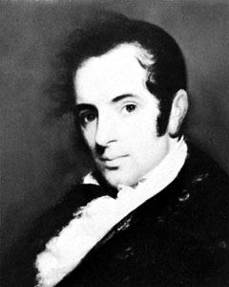
Washington Irving
While living in Europe, Irving, studied European folklore, including Faust and the Brothers Grimm.
This research influenced his writing greatly.
Romantic writers felt that folklore contained the secret and primitive dreams of the people and also intriguing elements of the supernatural.

Slide 49
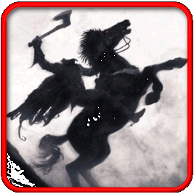
Washington Irving
Two of his best-known stories are “Rip Van Winkle” and “The Legend of Sleepy Hollow,” both appearing in The Sketch Book of Geoffrey Crayon, Gent. (1819-1820).
These stories and others like them provided American legends and helped shape an American folklore.

Slide 50
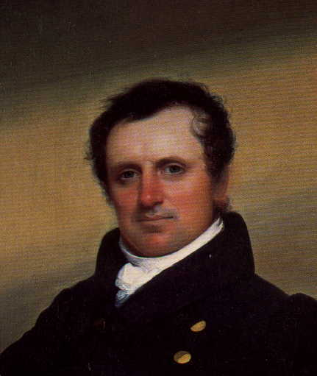
James Fenimore Cooper
James Fenimore Cooper was a master of historical fiction
Along with Irving, he was one of the few writers who could make a living by writing.

Slide 51
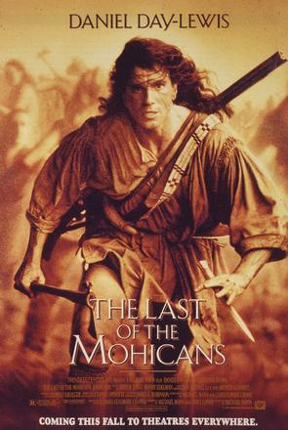
James Fenimore Cooper
Cooper wrote a series of five novels called the Leatherstocking Tales, which includes The Last of the Mohicans, focusing on the adventures of Natty Bumppo, a white man living among Native Americans in the forests of the American Northeast
Native Americans are portrayed as “noble savages” in Cooper’s work.

Slide 52
Romantic Literature
Characteristics
Sentimentalism (The Sketch Book – Irving)
Primitivism & the cult of the noble savage (Cooper)
Celebration of natural beauty & the simple life (Cooper, Emerson, Thoreau)
Introspection (Thoreau, Poe)
Idealization of the common man, uncorrupted by civilization (Cooper)

Slide 53
Romantic Literature
Interest in the picturesque past (Irving, Hawthorne)
Interest in remote places (Melville)
Concern with a world of mystery; morbid, melancholy (Poe)
Individualism (Emerson, Thoreau, Whitman)
Humanitarianism (Uncle Tom’s Cabin)

Slide 54
Common Characteristics of Romantic Fiction
NATURE: Celebration of natural beauty & the simple life (also the sublime in nature)
THE PAST: Interest in the picturesque past
THE SUPERNATURAL: Concern with a world of mystery; morbid, melancholy
HUMAN NATURE: Exploration of human emotion and individualism

Slide 55
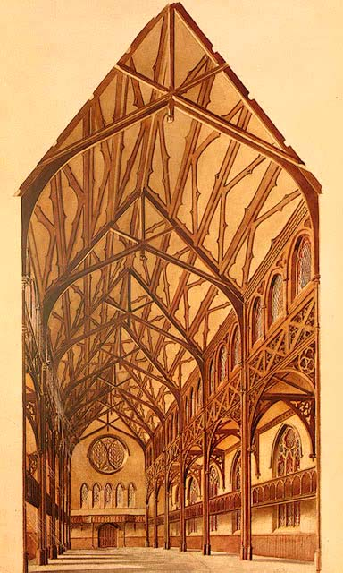
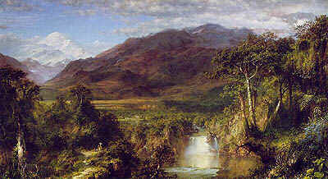
American Romanticism
Art & Architecture
The Hudson River School
The Gothic Revival

